Slide 1



Dip in 7
Lesson 6
Association game 2

Slide 2
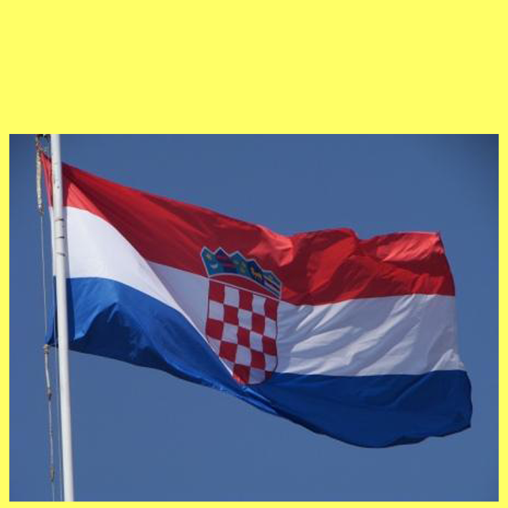
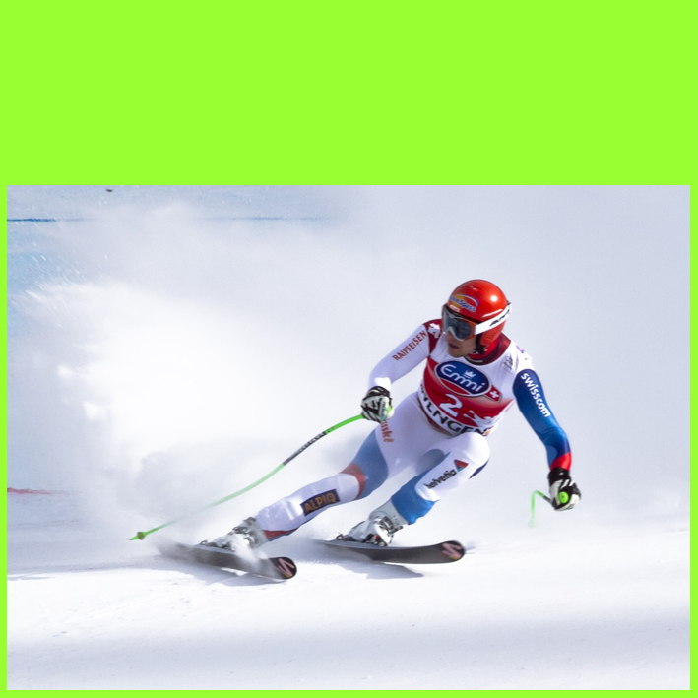
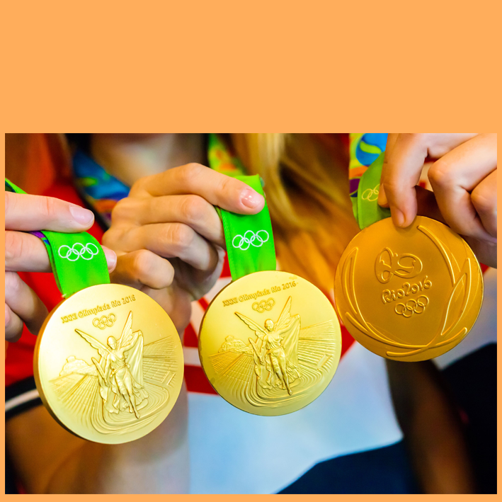
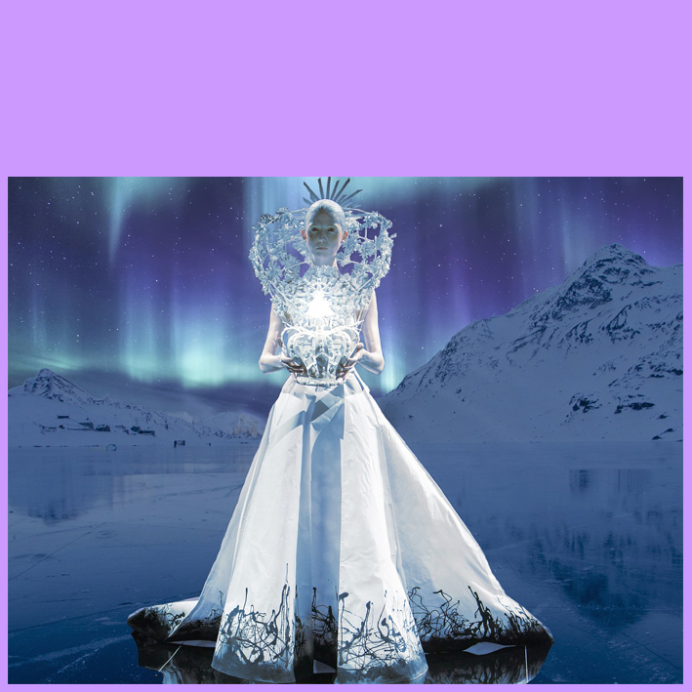

A1
a country
B1
slope
C1
2×3
D1
snow
red-white-blue
sticks
gold
A2
B2
C2
D2
ice
the Plitvice Lakes
goggles
silver
crown
A3
B3
C3
D3
A4
red & white squares
B4
skis
C4
bronze
fairy tale
D4
COLUMN A
COLUMN C
CROATIA
COLUMN B
6 MEDALS
SKIING
SNOW QUEEN
COLUMN D
THE FINAL ANSWER
JANICA KOSTELIĆ

